Slide 1

ML Random Forest Model and analysis
By: Dhanashree Nangre

Slide 2
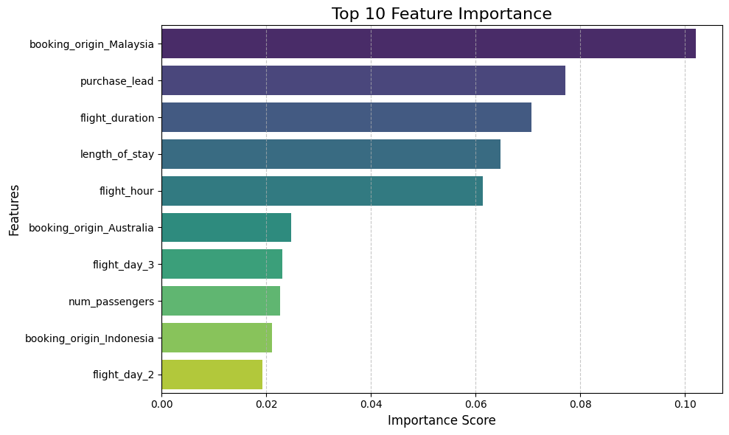
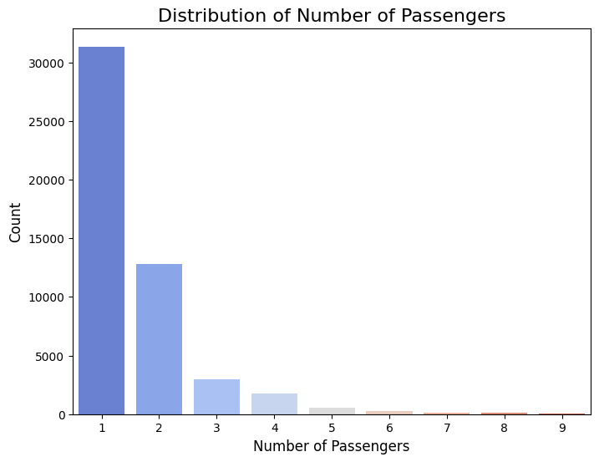
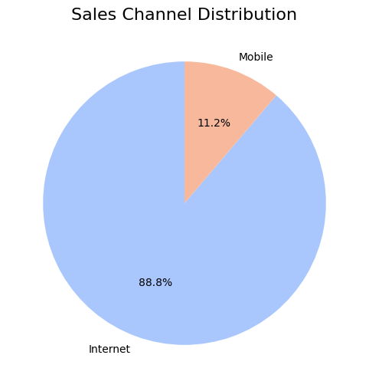
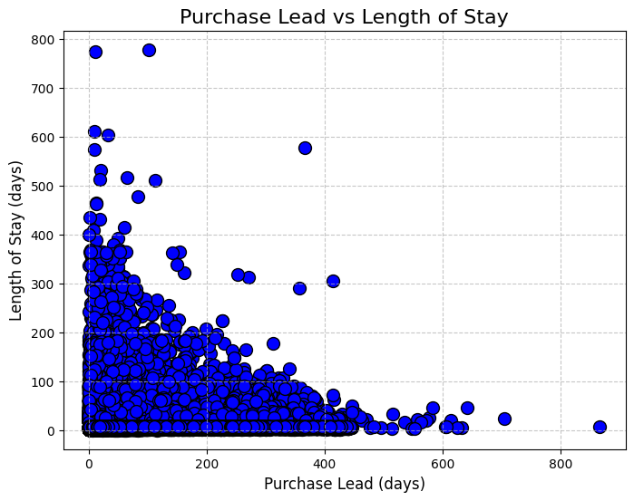
Based on this conclusion flight duration, length of stay, flight hour and number of passengers affect decision of booking will be made or not

